Slide 1
Urban Tour Group
Life in the City Tour
Portland, Oregon
www.urbantourgroup.org

Slide 2
Life in the City of Portland, 1870

Slide 3
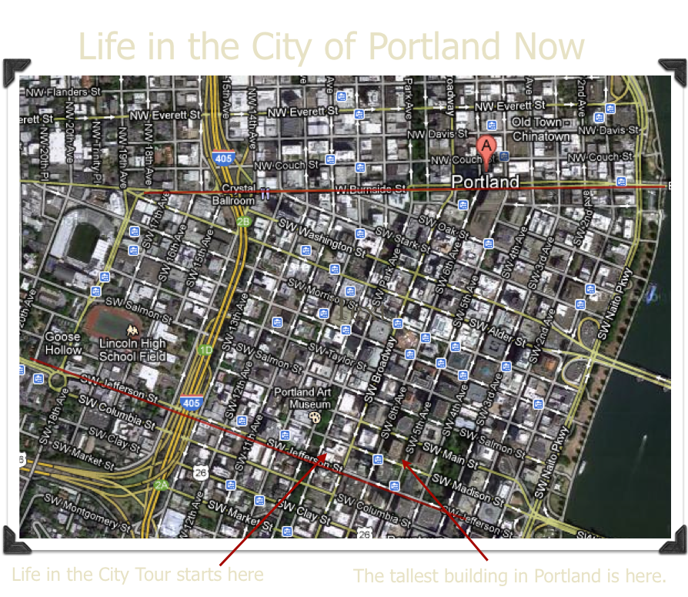

Slide 4
Life in the City
You will see many buildings and examples of public art in downtown Portland. You hear many stories about what it was like to live in Portland along time ago.
Not all tours are alike. You may see different sights during your two hour tour.

Slide 5
Many people work and live downtown.
Here are a few jobs you may see. What kind of jobs existed 150 years ago before paved streets, trains, and electricity?

Slide 7
Settlers came to live in the Oregon Territory after the Lewis and Clark Expedition in the early 1800’s.

Slide 8
Why do you think a large copper penny was important in naming Portland?

Slide 10
This is a drawing of the South Park Blocks long ago. Your tour will begin here.
What do you think you will see in the Park Blocks?

Slide 11
During your walk, you will see some old and new buildings. What were older building made of? What materials are used in new buildings?
Look for Greek columns, dentils and egg patterns inside and on the outside of older buildings.

Slide 12
City Hall
Both of these buildings are on the National Register of Historic Places. Do you know why?

Slide 16
Some art is very big and tells a story about Portland’s history.

Slide 17
How many statues of animals and animal prints do you think you will see as you tour downtown?
Why do you think animals are part of the public art of Portland?

Slide 18
Statues and pictures of people that helped shaped our country, state and city will be seen on the tour. Do you know who this is?

Slide 19
Some of the newest and oldest public art is made of glass.
In what kind of building will you find each of these brightly colored works of art?

Slide 20
You will be walking in the Cultural District of Portland. Culture is related to the arts, learning, and good manners. What do you think you may see in the cultural area of any town?

Slide 26
We hope you will enjoy your tour.

