Slide 1
Urban Tour Group
Building a City Tour

Slide 2
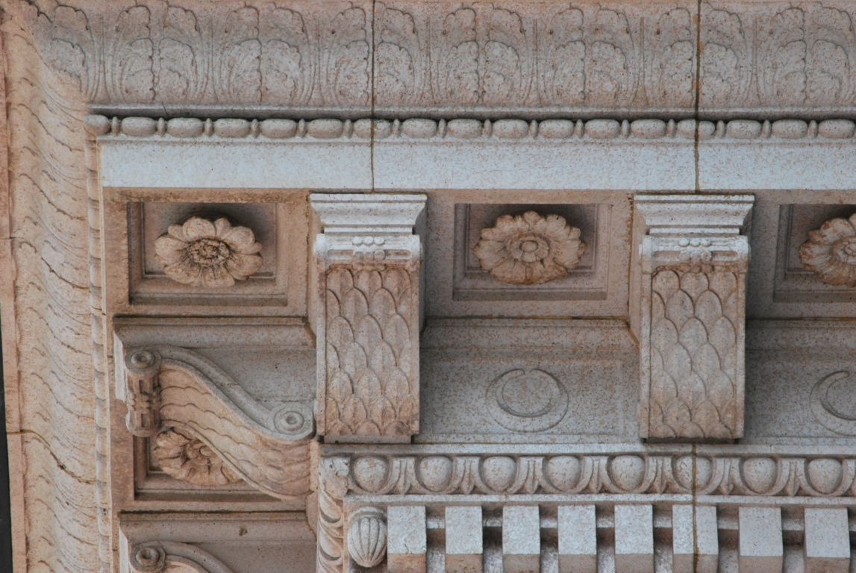
BUILDING A CITY pre-tour
Things you might see on your trip

Slide 3
Your tour guides are delighted you have chosen to take this tour.
We want you to have the best field trip of the year.
We will try to make it as fun and as informative as possible.
You will learn many facts and hear interesting stories during your trip.

Slide 4
This slide show will introduce you to many of the sites you will see.
Each guide may take you to different places and when you get back to class you can share your experiences with your classmates.

Slide 5
You will learn what Portland was like over
100 years ago and see how the town has been built into the beautiful city it is today.

Slide 6
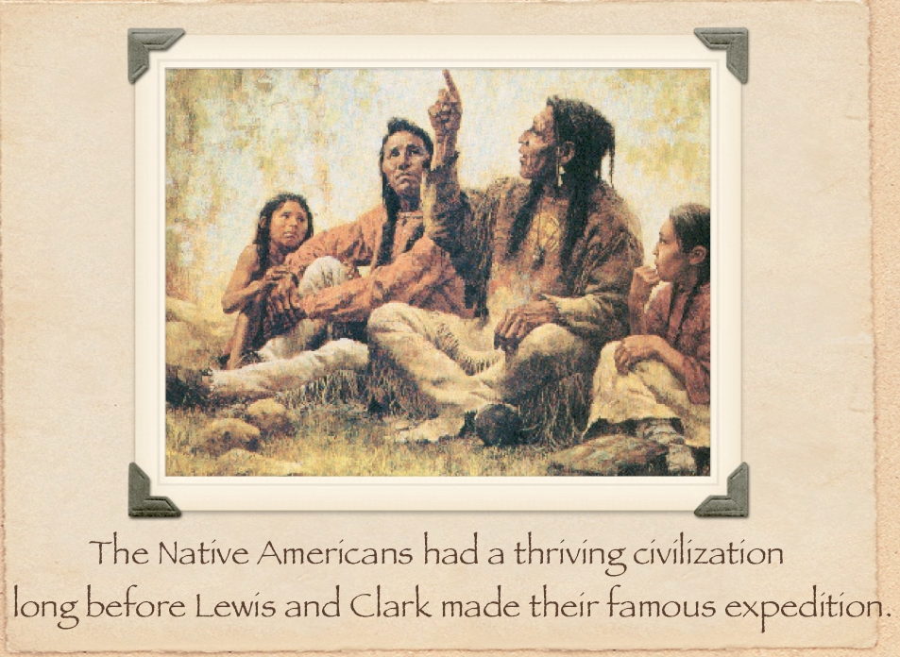

Slide 7
Lewis and Clark arrived in 1805.
Portland was explored by pioneers in the 1840’s.
Portland grew by leaps and bounds in the early 1900’s.
You will see how we have progressed into the 2000’s.

Slide 8
There are many people who helped Portland become famous.
Here are some of them. . .

Slide 9
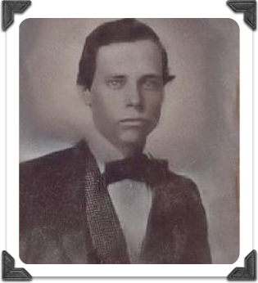

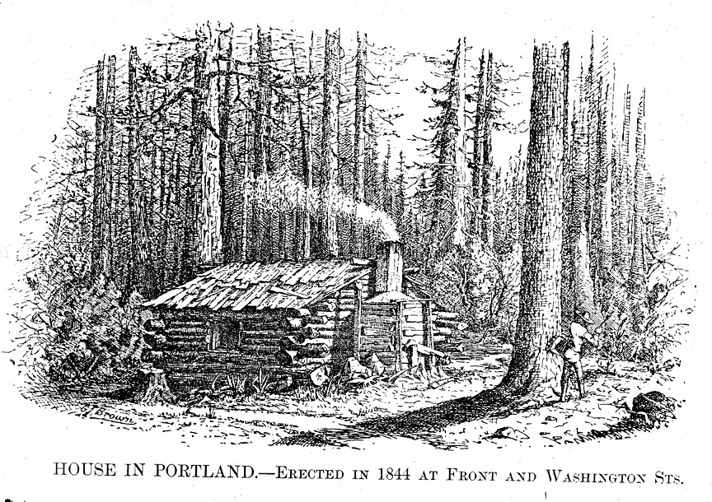
Text
This cabin was named for William Overton. In late 1843, Native American guides took Overton and his companion, Asa Lovejoy, to “the clearing,” where the guides stopped the canoe for a noonday break. Overton suggested that the clearing, in-between Fort Vancouver and Oregon City might make a good settlement. Lovejoy, a lawyer, agreed to pay the twenty-five cent fee to file a claim with the provisional government in exchange for half the 640 acres they believed would be available soon to each immigrant.
Little is known of Overton, who was something of a drifter. In the spring of 1844, he sold his 320 acres to Oregon City shopkeeper, Francis Pettygrove, for about fifty dollars, probably paid in provisions. This was the first of several early transactions involving the townsite tract, some of which resulted in such confusion that disputed ownership issues had to be resolved in court. Overton headed for the Southwest, while an employee of Pettygrove and Lovejoy built and lived in the cabin that bore Overton’s name.
Pettygrove and Lovejoy “snapped a copper” — flipped a coin — to decide the settlement’s name. Both men were from New England, and each favored the name of a town from his home state. Pettygrove was from Maine and preferred Portland. Lovejoy was from Massachusetts and favored the name Boston.
Overton’s cabin

Slide 10

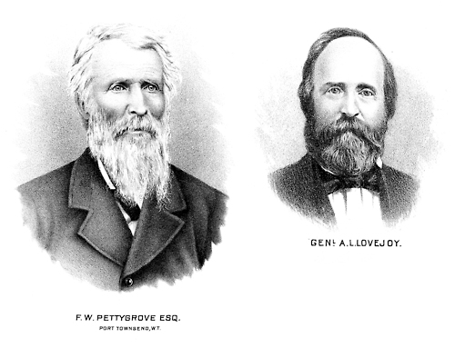

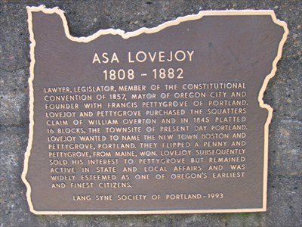

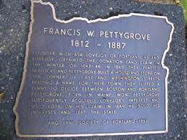

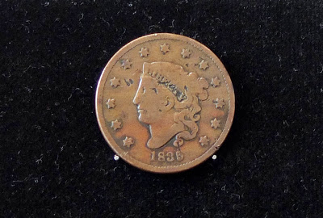
Lovejoy
from
Massachusetts
Pettygrove
from
Maine
FOUNDERS
OF PORTLAND
TOSS THE COIN in 1845
Guess who won!

Slide 11

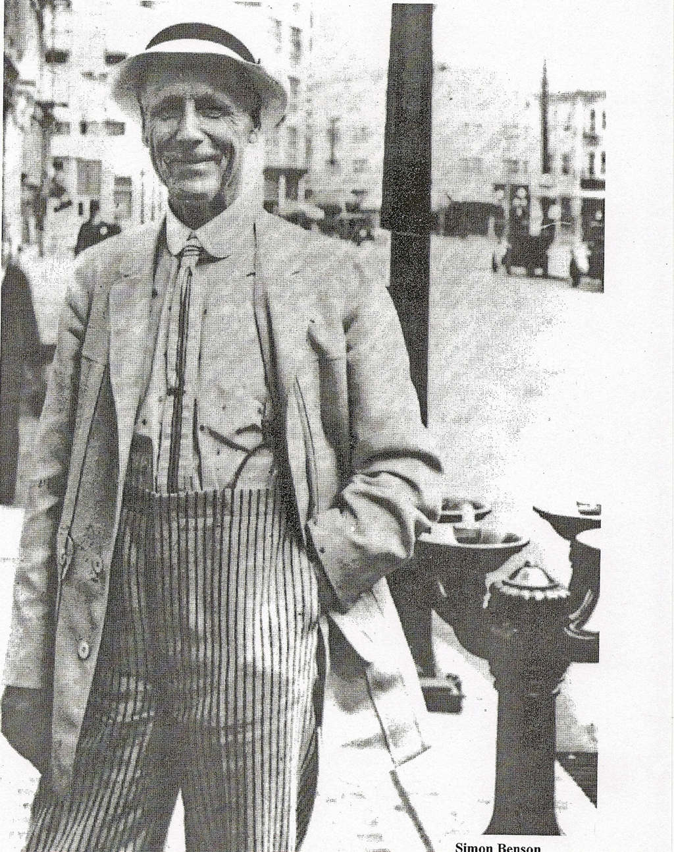

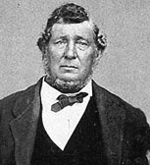
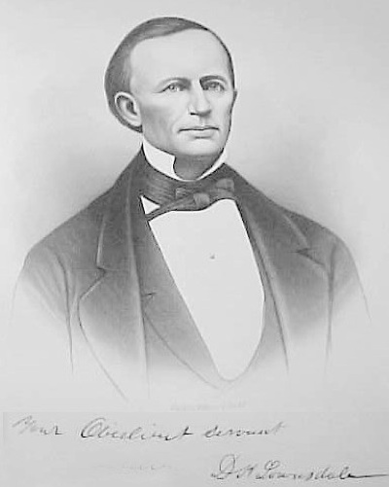
Several early pioneers worked together to develop a plan for Portland. They purchased land for parks, planted trees and flowers, built schools, and set up businesses to promote commerce. Pettygrove, Lovejoy, and Capt. Couch were important in the 1800’s.
A.E. Doyle, Belluschi, Simon Benson and many others helped to develop and build our city and its suburbs in the 1900’s.
Streets and Parks are often named after these early pioneers.
Capt. John Couch

Slide 12


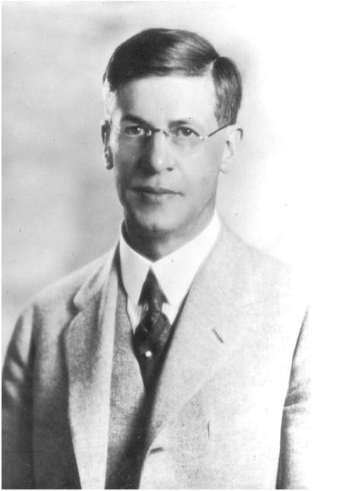
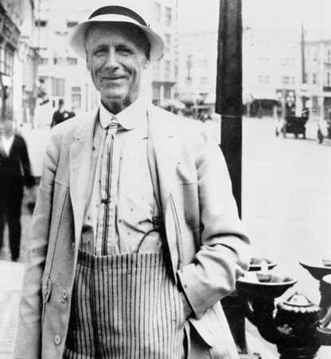

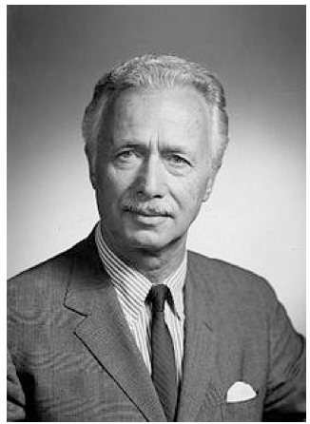
These famous
men
influenced
Portland
development
SIMON BENSON
PHILANTHROPIST
A.E.DOYLE
ARCHITECT
PIETRO BELLUSCHI
ARCHITECT

Slide 13


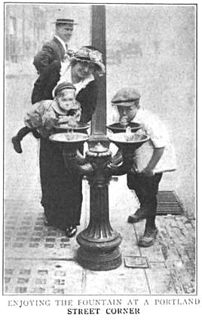

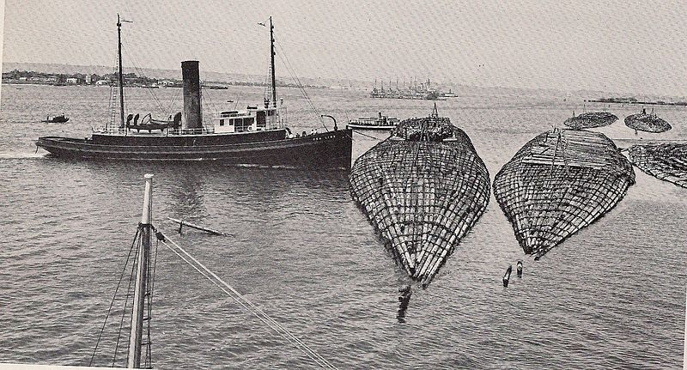

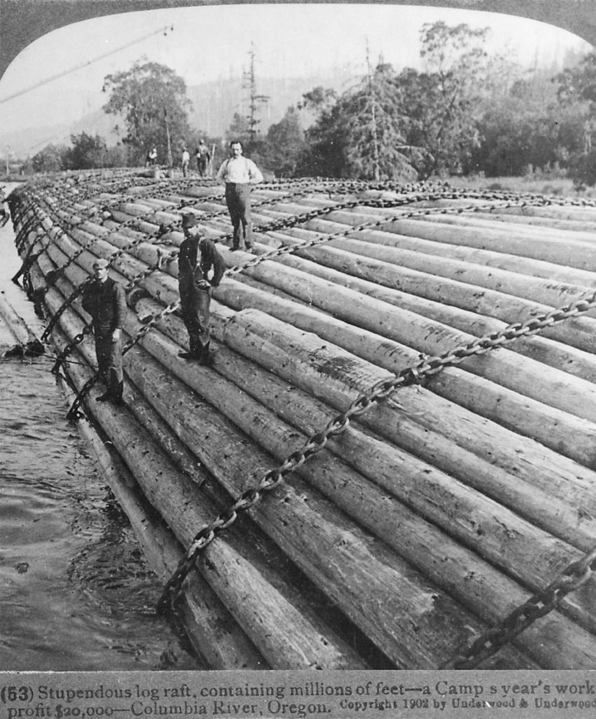

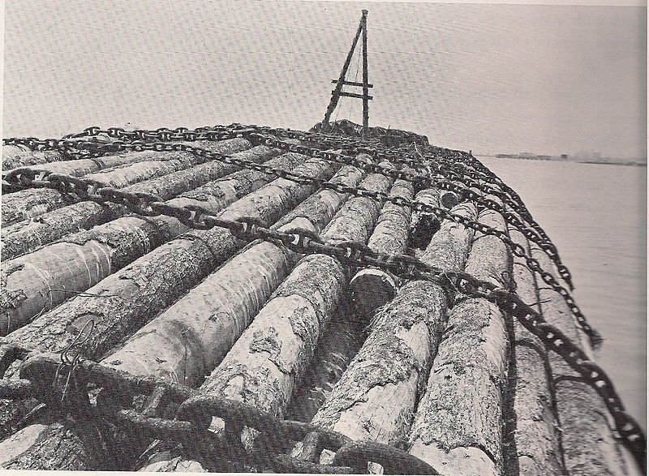

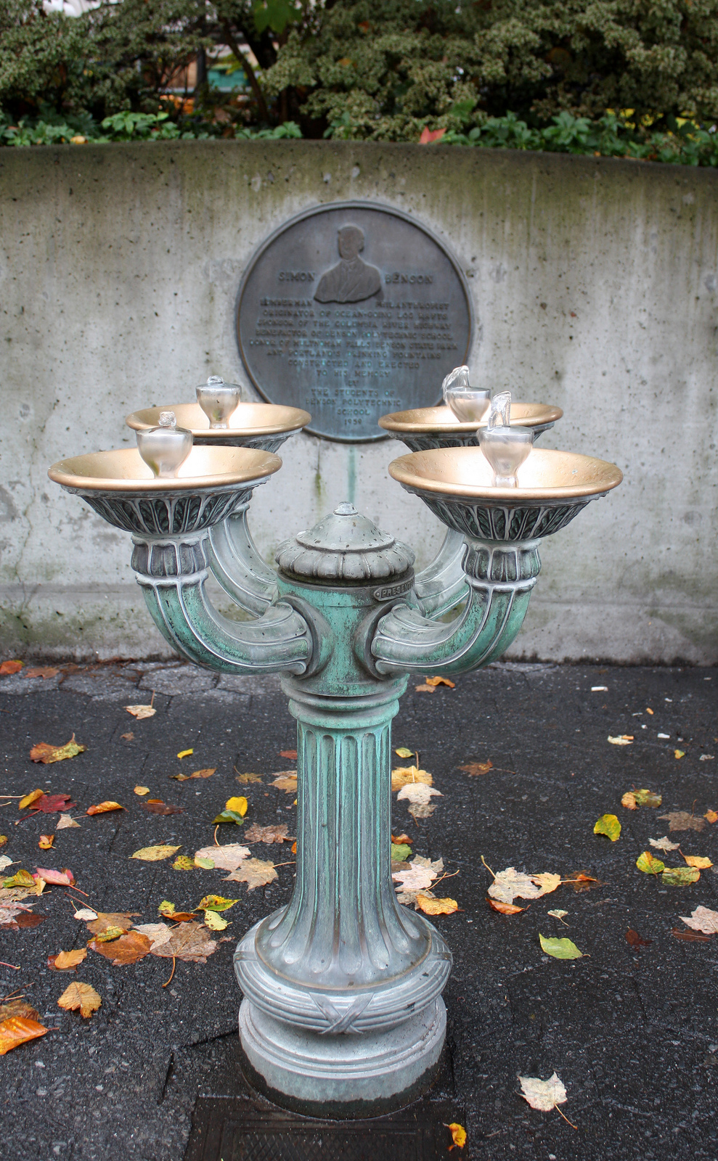
Simon Benson - Philanthropist
Benson was famous for his bubblers and his logging.

Slide 14

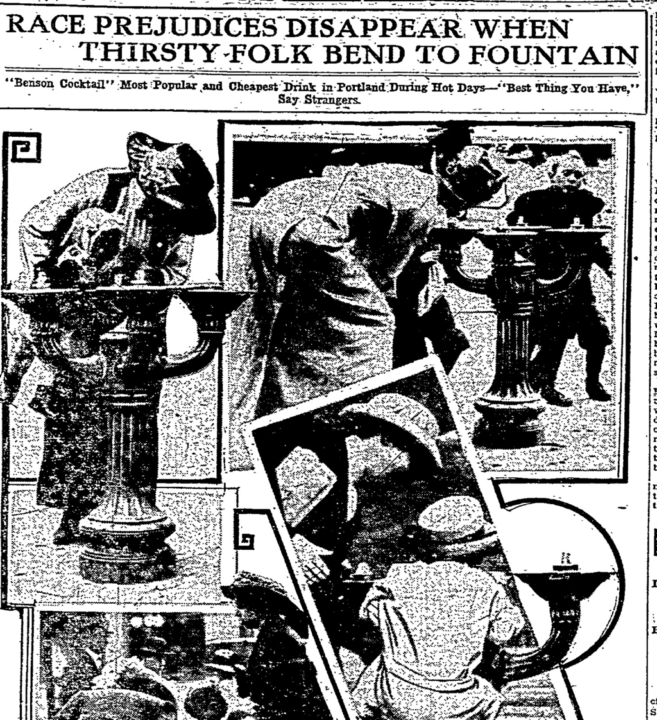
"Race Prejudices Disappear When Thirsty Folk Bend to Fountain"
-The Sunday Oregonian, July 27 1913.
"...the "color line," however well defined it may be at other places, recedes to the vanishing point on a hot afternoon at the at the corner of Sixth and Alder, Fifth and Washington or any of the other 20 odd corners in the city where, night and day, the Benson fountains bubble their little song of welcome and generosity."
-The Sunday Oregonian, July 27 1913.

Slide 15


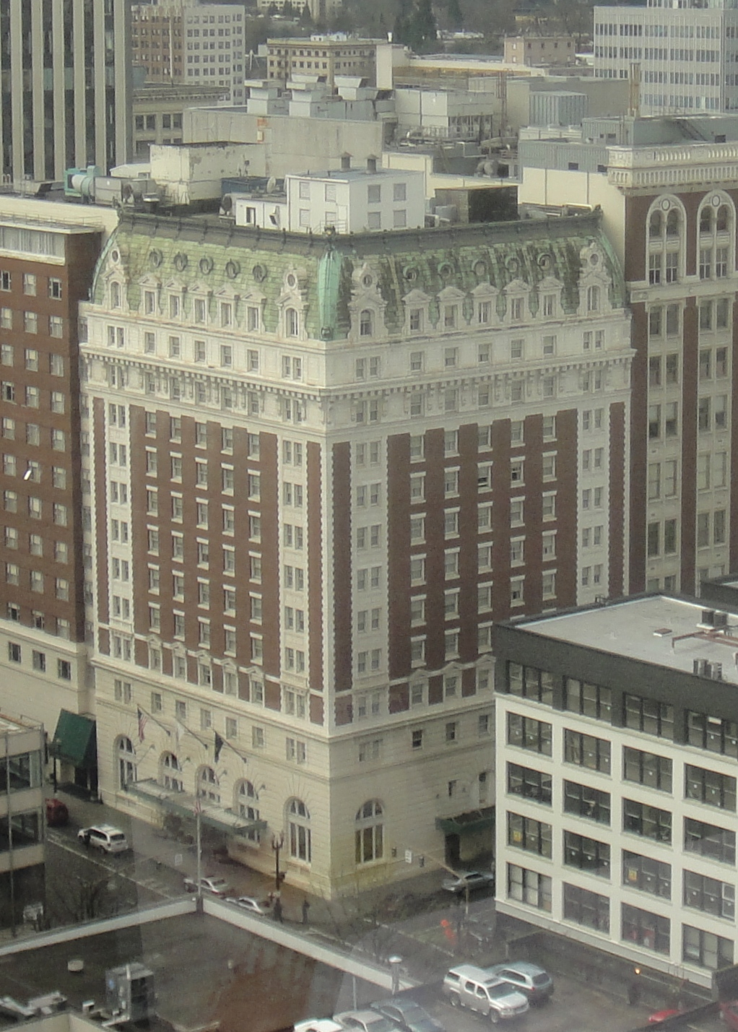
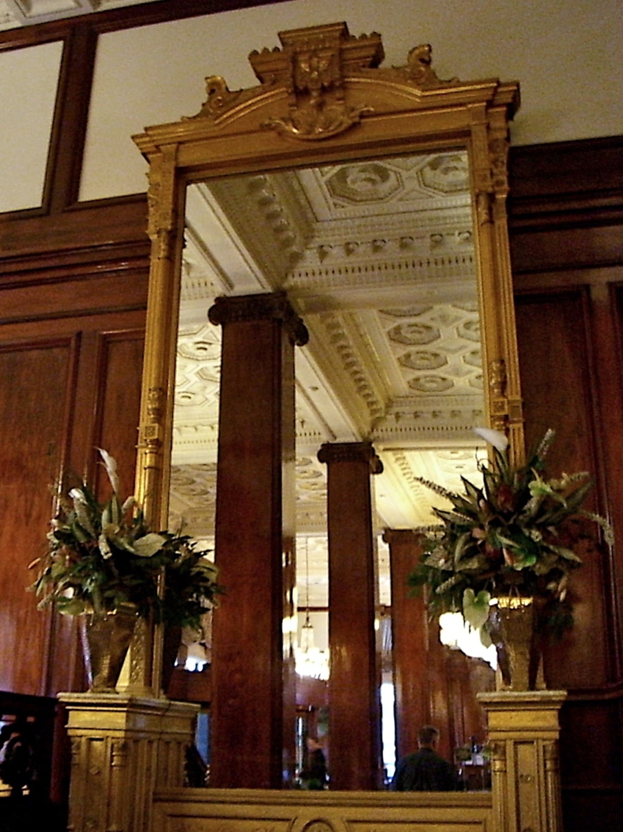

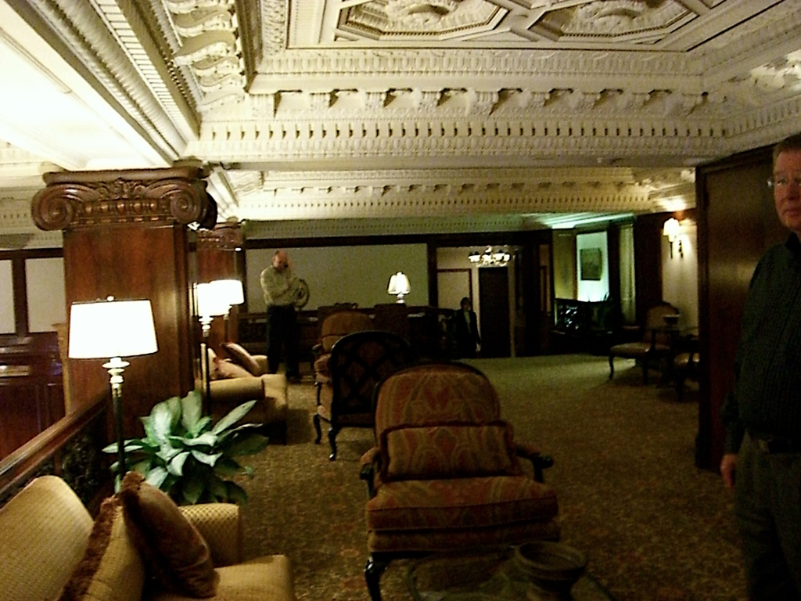
Benson built
this beautiful
hotel for visitors
to Portland.

Slide 16
YOU WILL LEARN ABOUT ARCHITECTURE and building materials:
TYPES OF COLUMNs:
DORIC
IONIC
COMPOSITE
CORINTHIAN

Slide 17
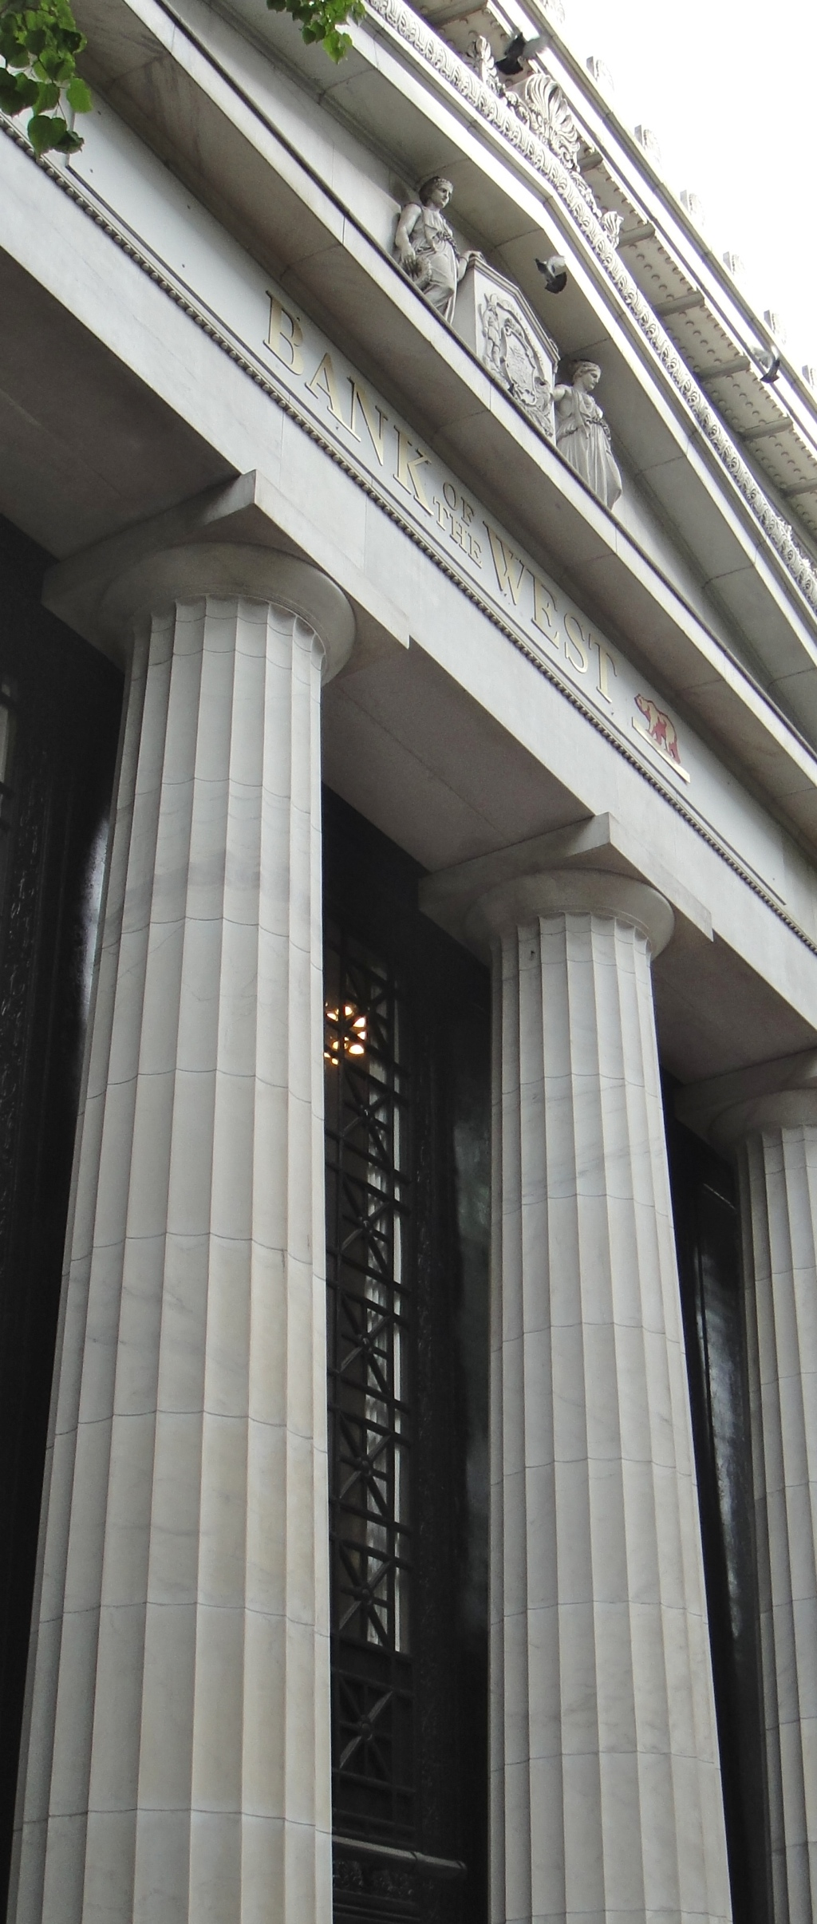
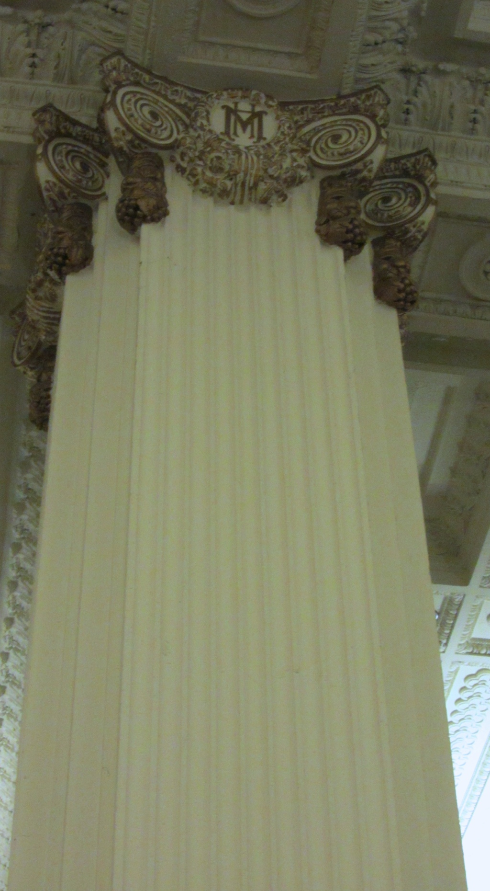
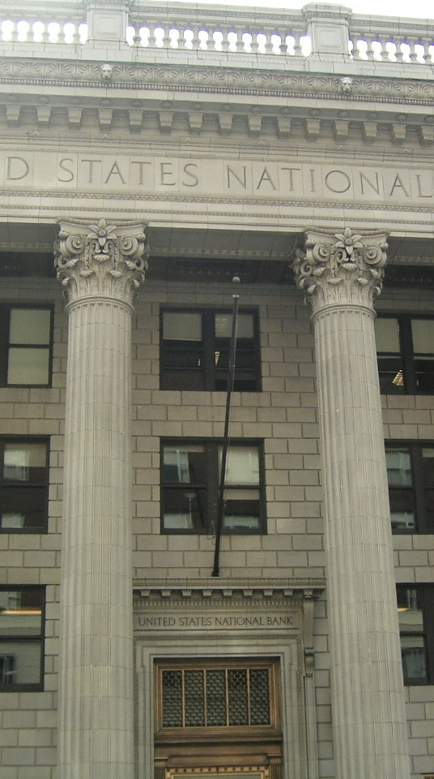
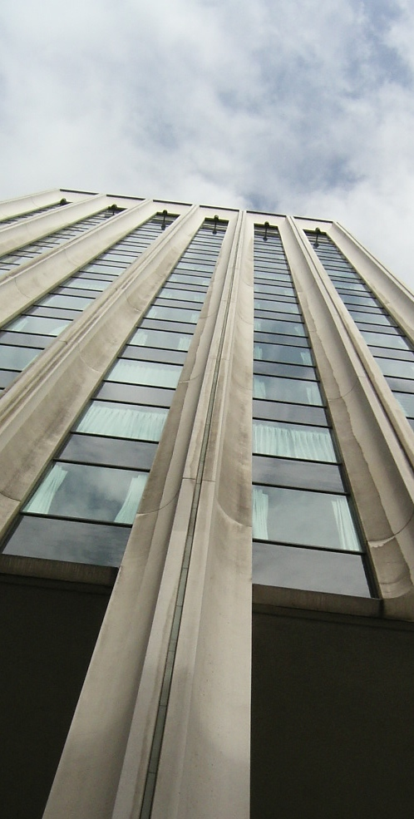
From log cabins to buildings on
the National Register of Historic Buildings
Corinthian
Columns
Composite
columns
Doric
columns
Modern
pillars

Slide 18
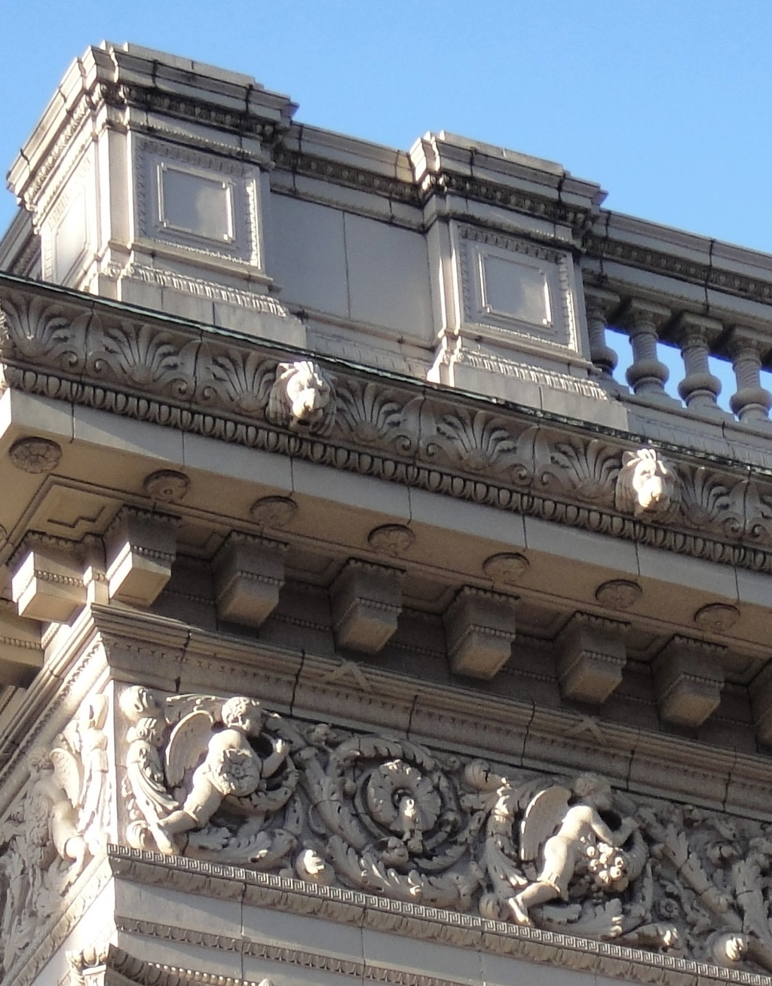
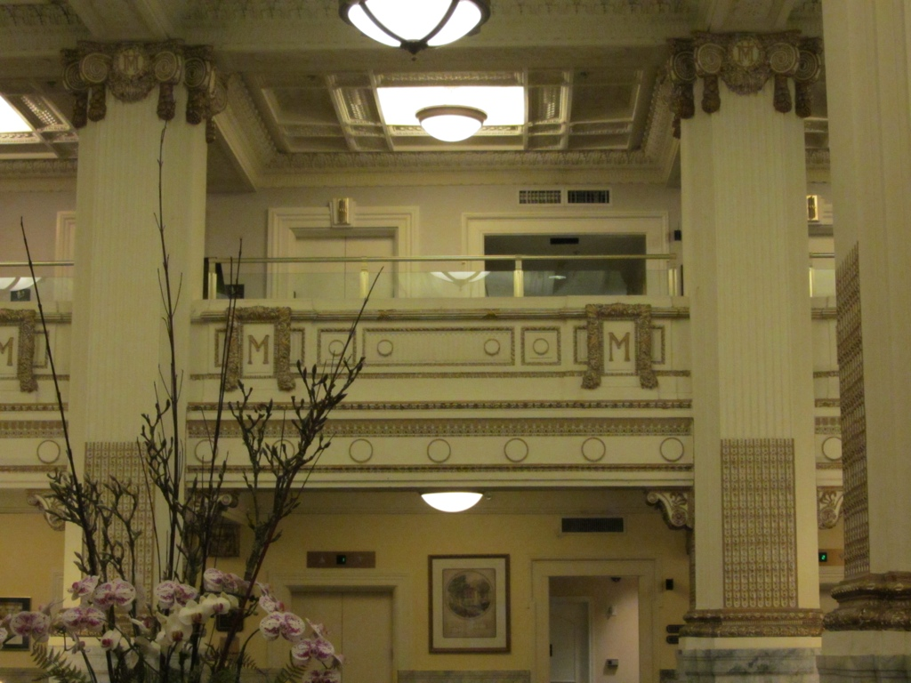

BUILDING STYLES & Terms:
Ballustrade, GARGOYLES
MEZZANINe & columns
EGG & DART, DENTILS

Slide 19


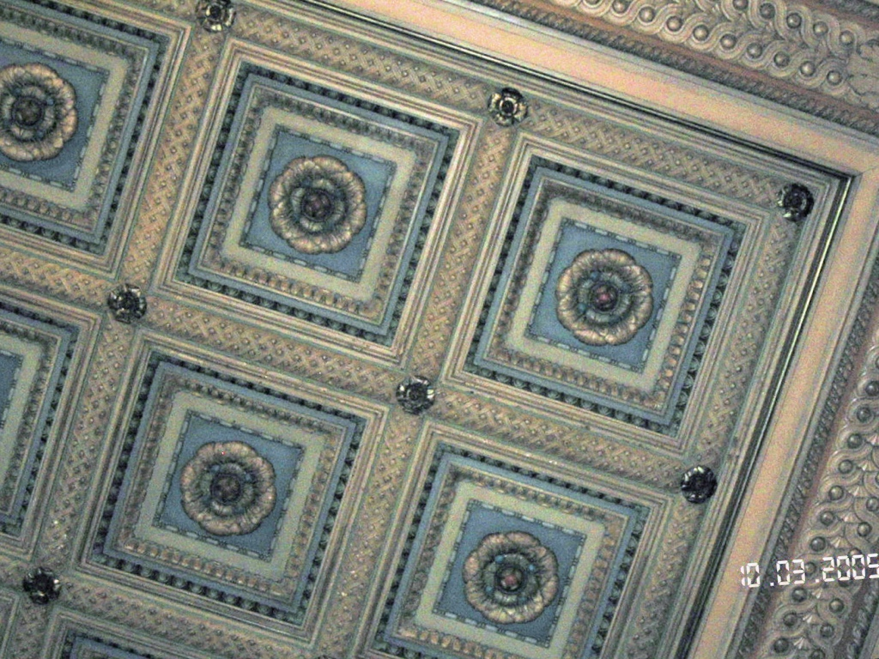

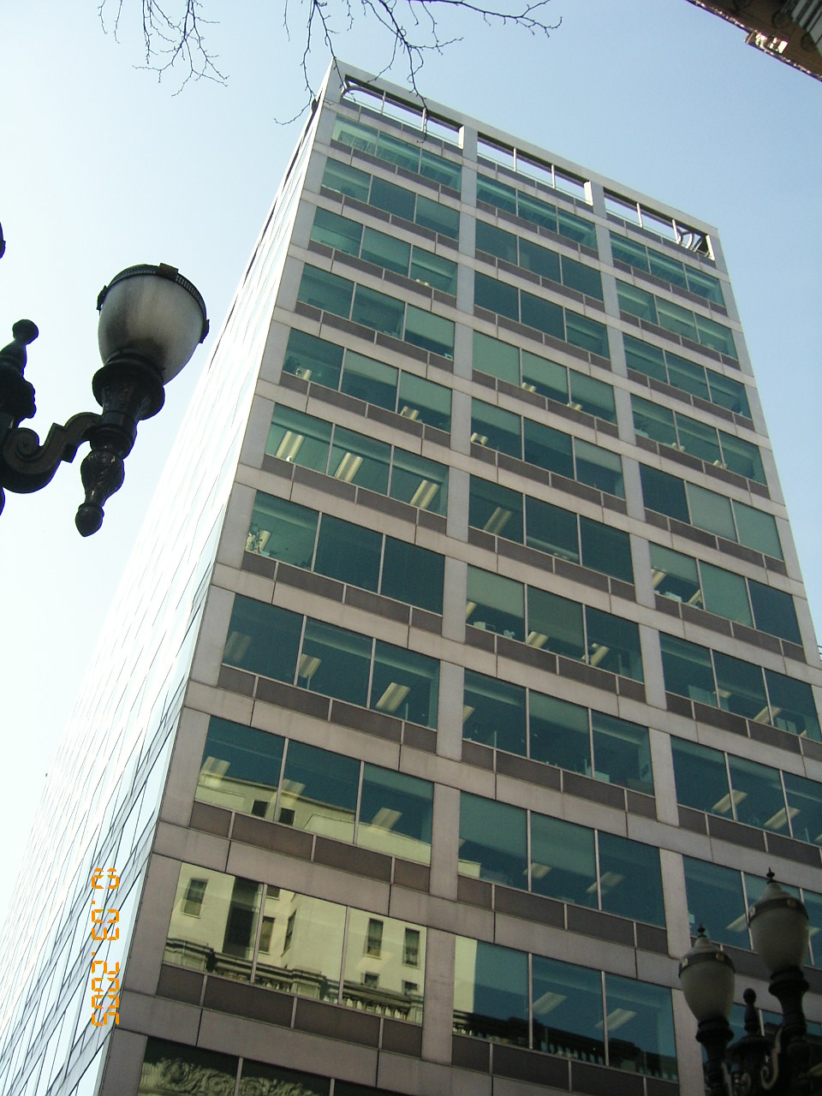
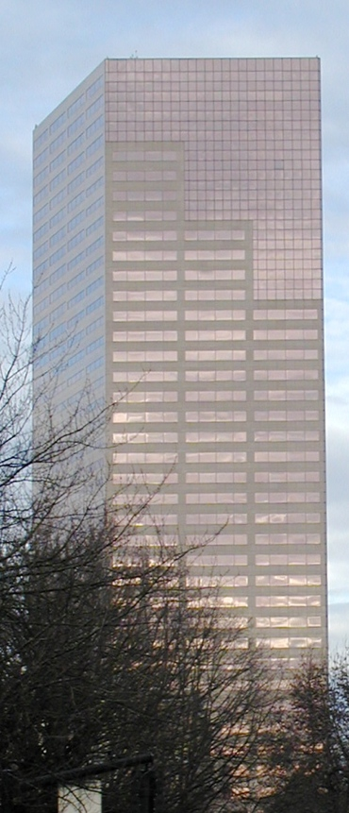

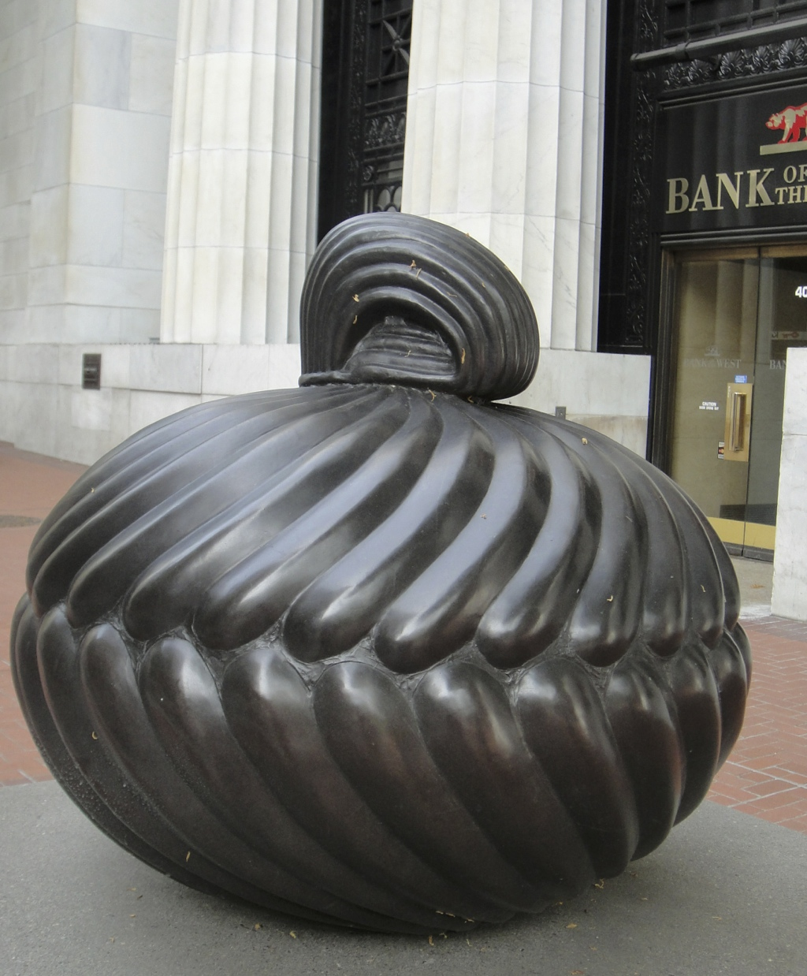
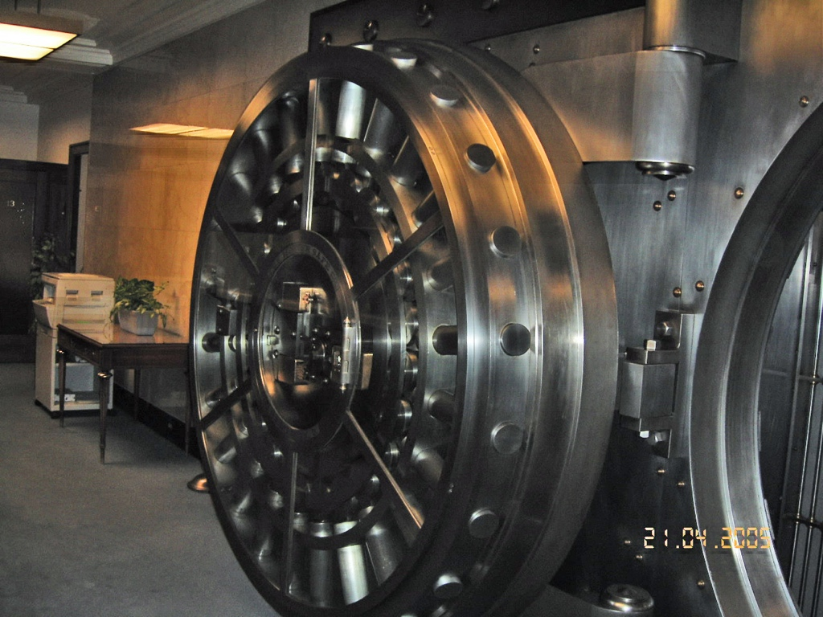
BUILDING MATERIALS:
MARBLE, GRANITE, TERRA COTTA, BRONZE,
PLASTER, STEEL, GLASS
plaster
glass
granite
steel
bronze

Slide 20
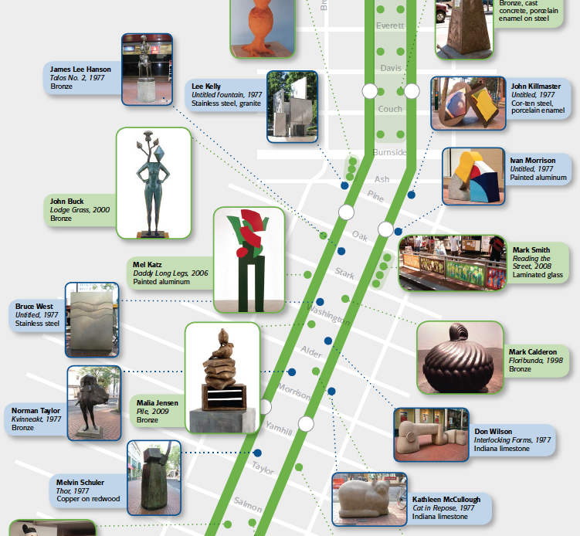
This is art you will see on the Transit Mall

Slide 21
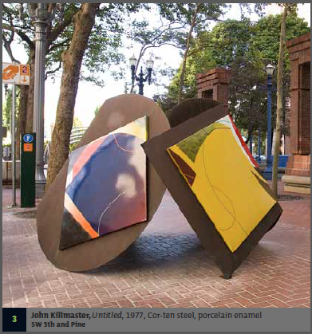
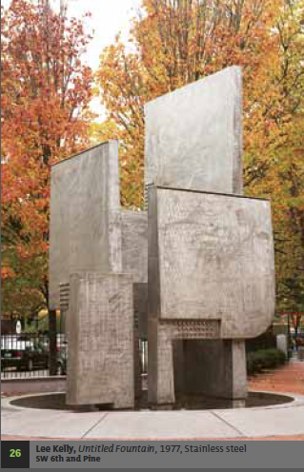
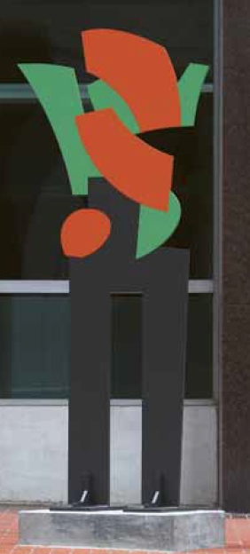
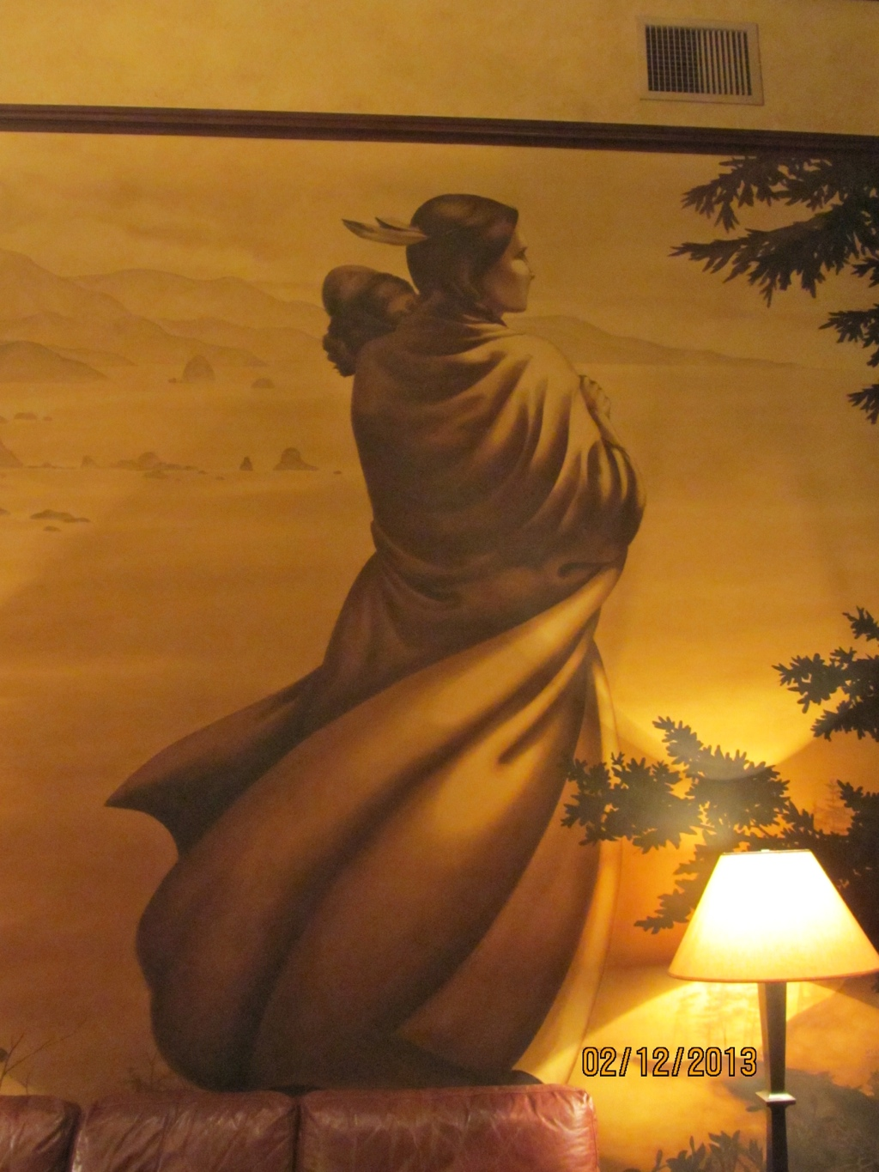
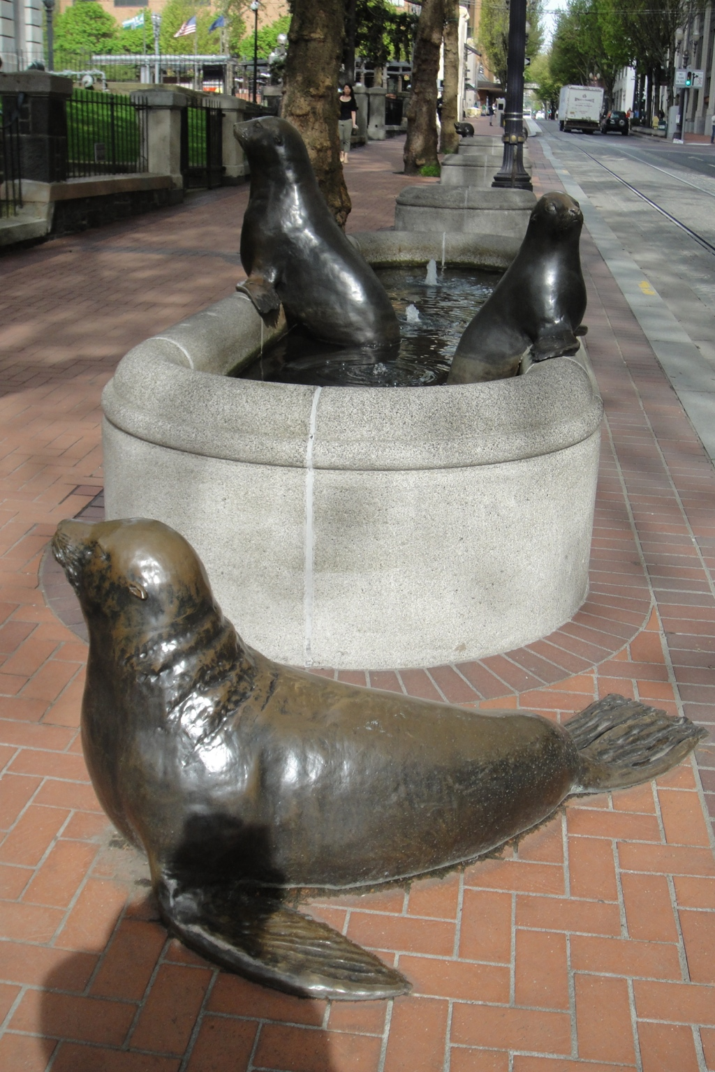
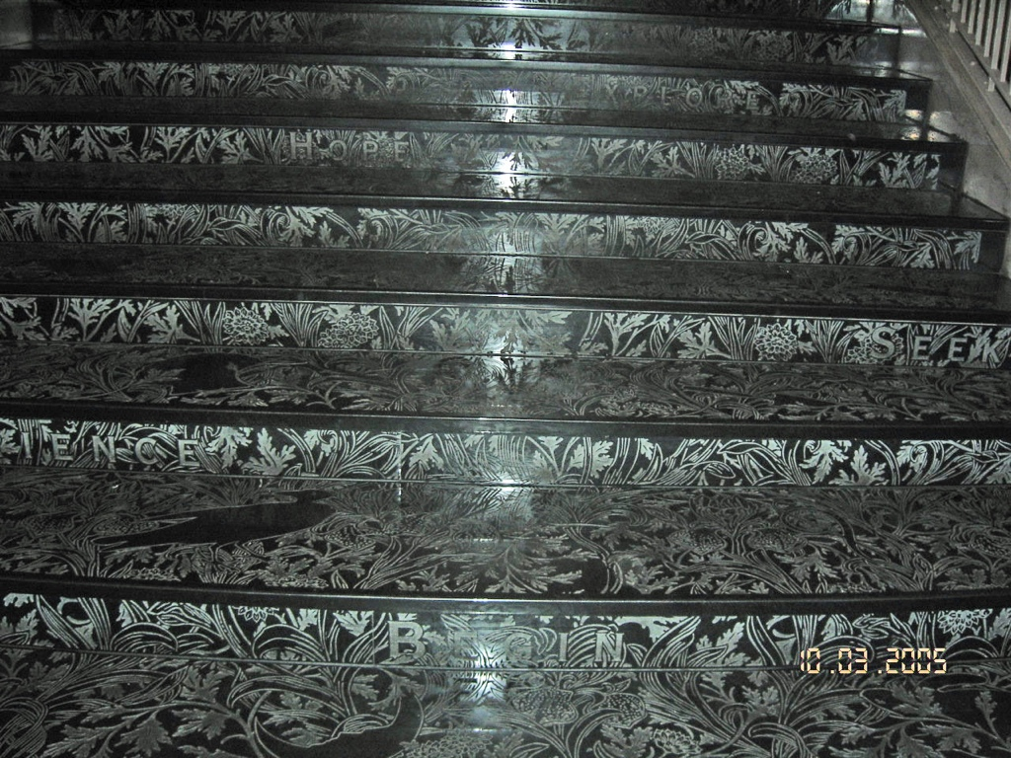
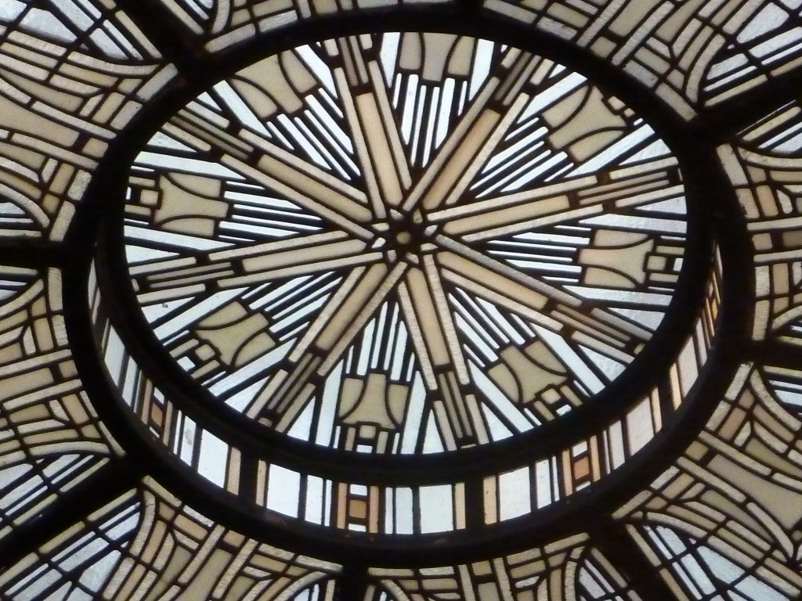
You will see public art everywhere:
enamel painted steel
bronze
stainless steel
fountain
painted aluminum
bronze
glass
mural
marble

Slide 22
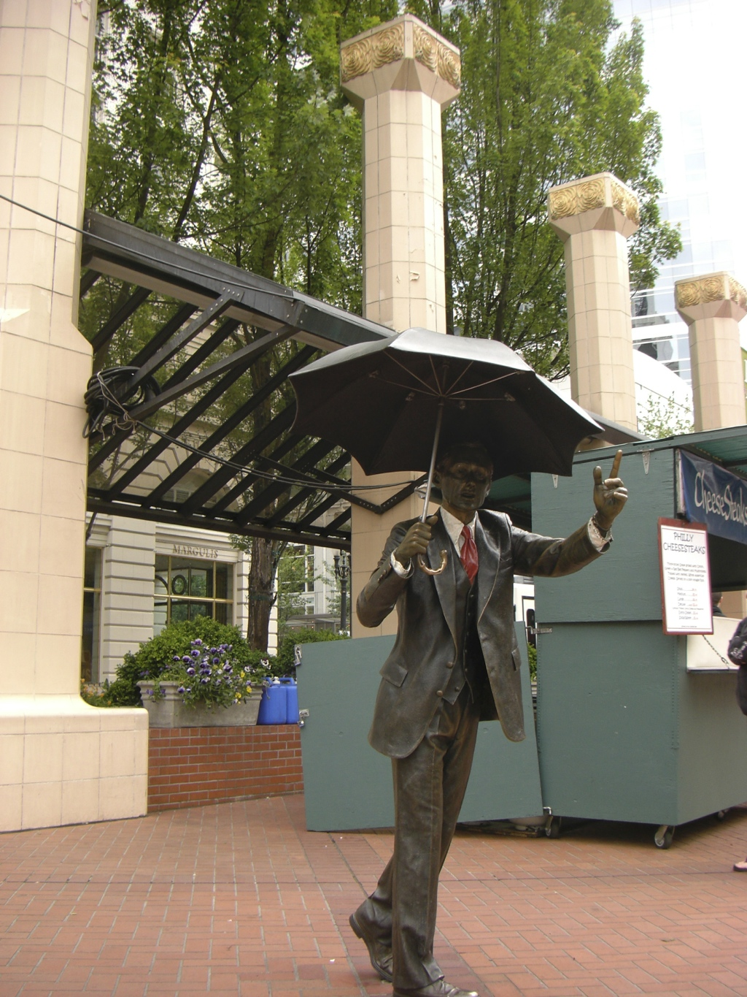
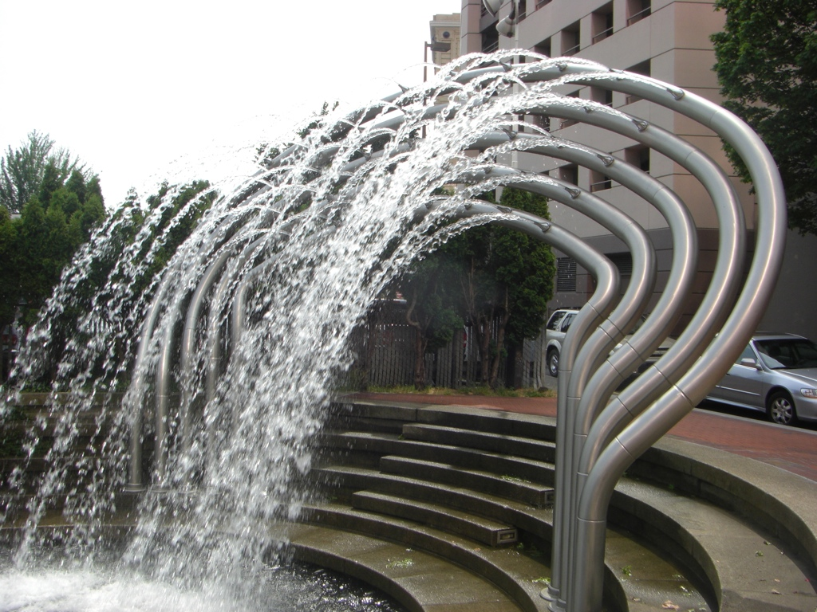
PUBLIC ART
INCLUDES STATUES,
SCULPTURES & FOUNTAINS

Slide 23
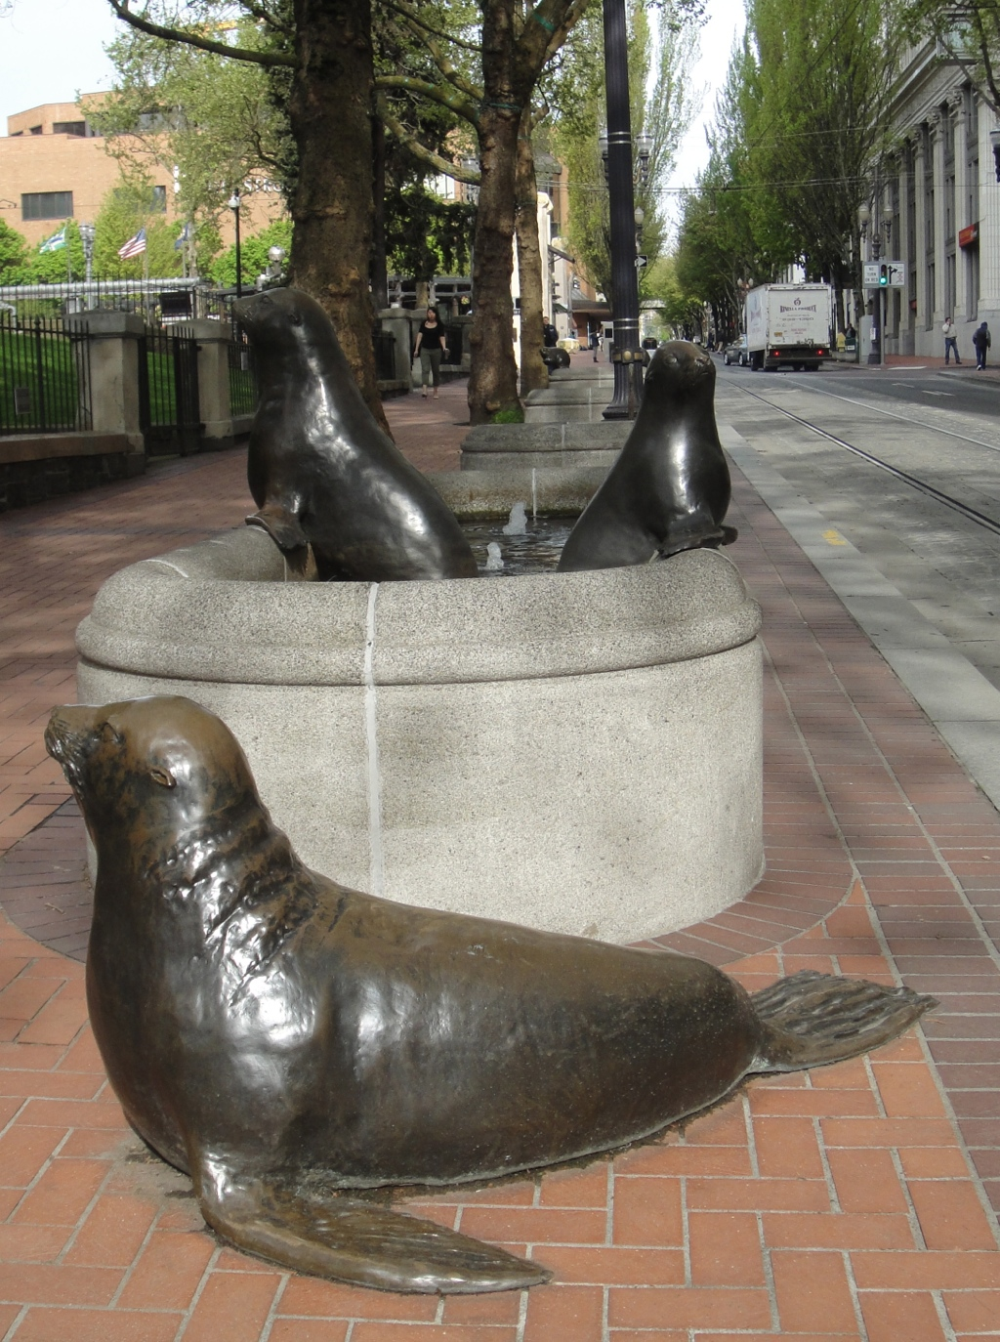
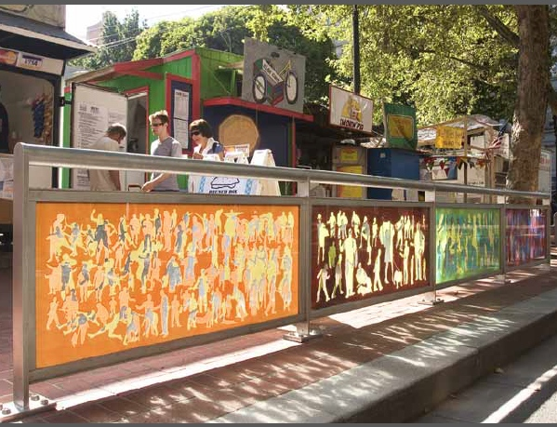
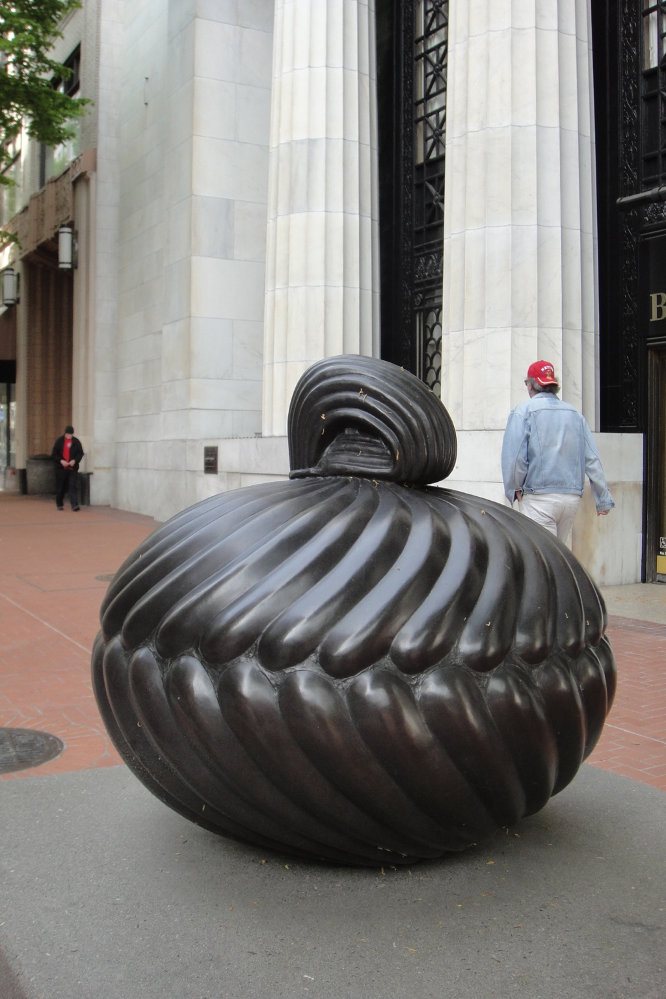
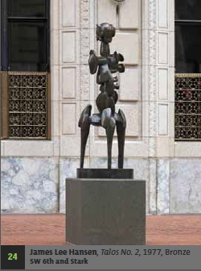

Slide 24
Portland has famous landmarks many of our buildings and places are on the National Register of Historic Buildings and Places.

Slide 25

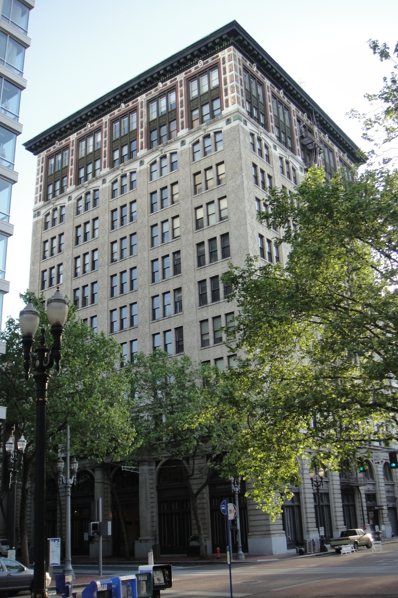

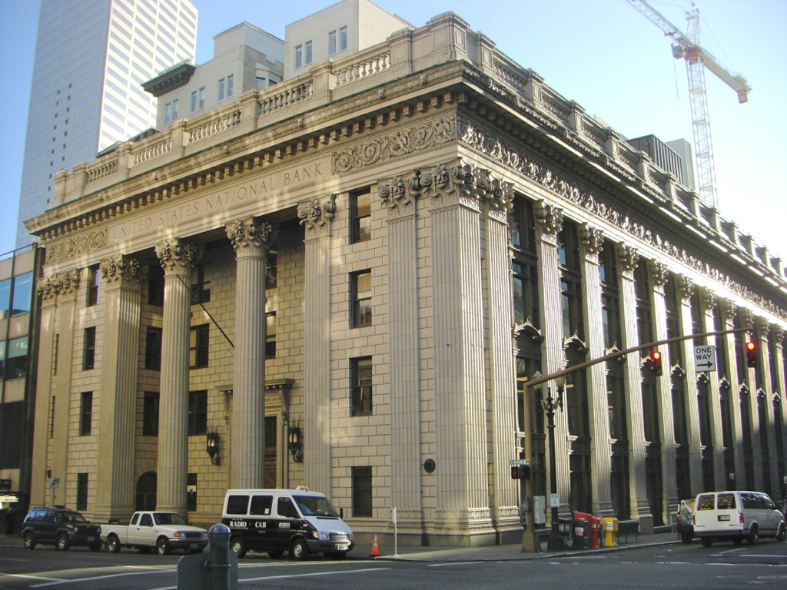





Here are some examples
of National Register of Historic Buildings

Slide 26





You will end your tour here.
at the Multnomah Library, it is also
on the National Register of Historic buildings.
by A. E. Doyle
1913
It is a
Portland
landmark.

Slide 27

Plan to be a good citizen on your Building a City tour.
Hotels and offices are very generous and allow us to see their properties. Please be very quiet when entering businesses.
Enjoy the riches of the city.
How can you be a good citizen
of the town where you live?

